Slide 1

Fault Tolerant
Computer System Engineering, Fall 2018. (IPADS, SJTU)
Reliable System from Unreliable Components
Yubin Xia

Slide 2
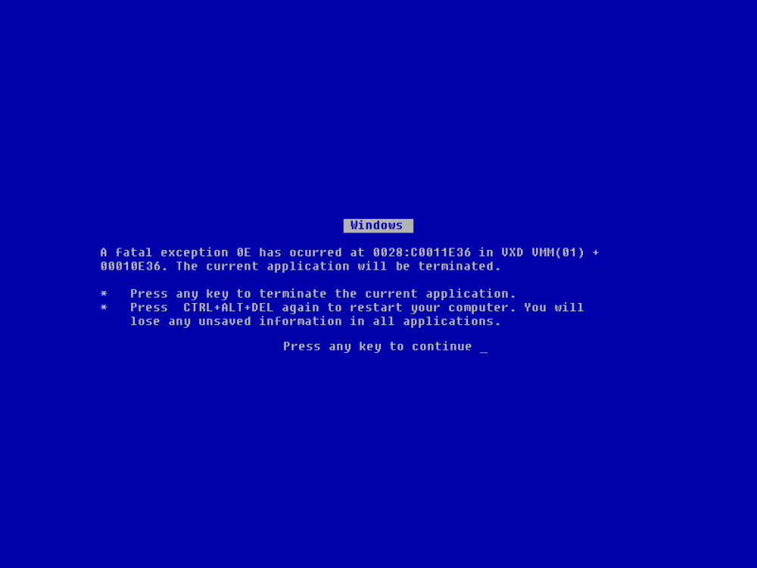

Slide 3
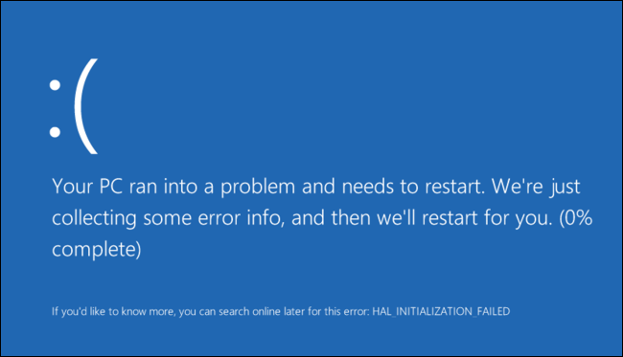

Slide 4
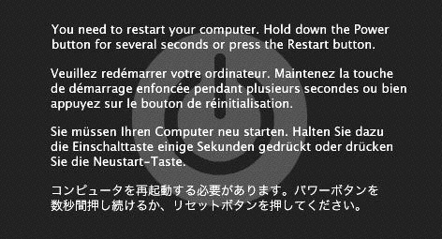

Slide 5
War Story
" It's good to learn from your mistakes. It's better to learn from other people's mistakes."
- Warren Buffett

Slide 6
War Stories: MAXC & Alto
MAXC
A time-sharing computer system
Using Intel 1103: 1KB memory
Fault tolerant
Extra bits for each 36-bit
Single-error-correction
Double-error-detection
Result
Solidly reliable
No errors were reported
Alto
A personal workstation
Using the same Intel memory chip
Fault tolerant
One parity bit for each 16-bit
Error-detection only
Result
Frequent memory-parity failures!
1. Bit-map display: Bravo
2. Pattern-sensitive 1103

Slide 7
War Stories: MAXC & Alto
Lesson-1:
There is no such thing as a small change in a large system
A new software can bring down previously working hardware
You are never quite sure just how close to the edge of the cliff you are standing
Lesson-2:
Experience is a primary source of information about failures
It is nearly impossible, without specific prior experience, to predict what kinds of failures you will encounter in the field

Slide 8
War Stories: MAXC & Alto, Chap-2
Back to MAXC: why so few errors at that time?
Hardware reports both corrected errors and uncorrectable errors
But software only logged uncorrectable errors!
Lessons
Safety margin principle is important when system implement automatic error masking
Otherwise, you may be standing on the edge again

Slide 9
War Stories: MAXC & Alto, Chap-3
New machine: Alto-2
Using new memory chip with 4096 bits
Single-error-correction, double-error-detection, again, flawlessly!
Two years later, an implementation mistake is discovered
Neither error correction nor detection was working on 1/4 cards!
Lessons
Never assume the h/w does as it says in the spec
It is harder than it looks to test the FT features of a FT sys
Just because it seems to be working does not mean that it actually is

Slide 10
Nowadays
Memory chip does become better
Errors often don't lead to failures
Bit-flip can be benign
But there are still errors
Sometimes, failure is blamed on something else
You never know it h/w error or s/w error

Slide 11
Fault, Error, Failure
Basic Concepts

Slide 12
Fault, Error, Failure
Fault can be latent or active
If active, get wrong data or control signals
Error is the results of active fault
E.g. violation of assertion or invariant of spec
Discovery of errors is ad hoc (formal specification?)
Failure happens if an error is not detected and masked
Not producing the intended result at an interface

Slide 13
Failure in System and Subsystem
The failure of a subsystem is a fault of a system
The fault may cause an error that leads to the failure of the larger subsystem
Unless the larger subsystem detects the error and masks it
Examples
A flat tire -> detects the error by failure of a subsystem
Miss an appointment -> the person notices a error
Change to a spare tire -> masked the error

Slide 14
Different Types of Faults
Fault Types |  | Types
Software fault |  | Programming mistakes
Hardware fault |  | A gate whose output is stuck at the value ZERO
Design fault |  | Assign too little memory in a telephone switch
Implementation fault |  | Installing less memory than the design called for
Operations fault |  | Running a weekly payroll twice last Friday
Environment fault |  | Lightning strikes a power line causing a voltage surge
Transient fault |  | Cosmic ray caused single bit flipped (soft error)
Persistent fault |  | A bit is stuck at zero (hard error)

Slide 15
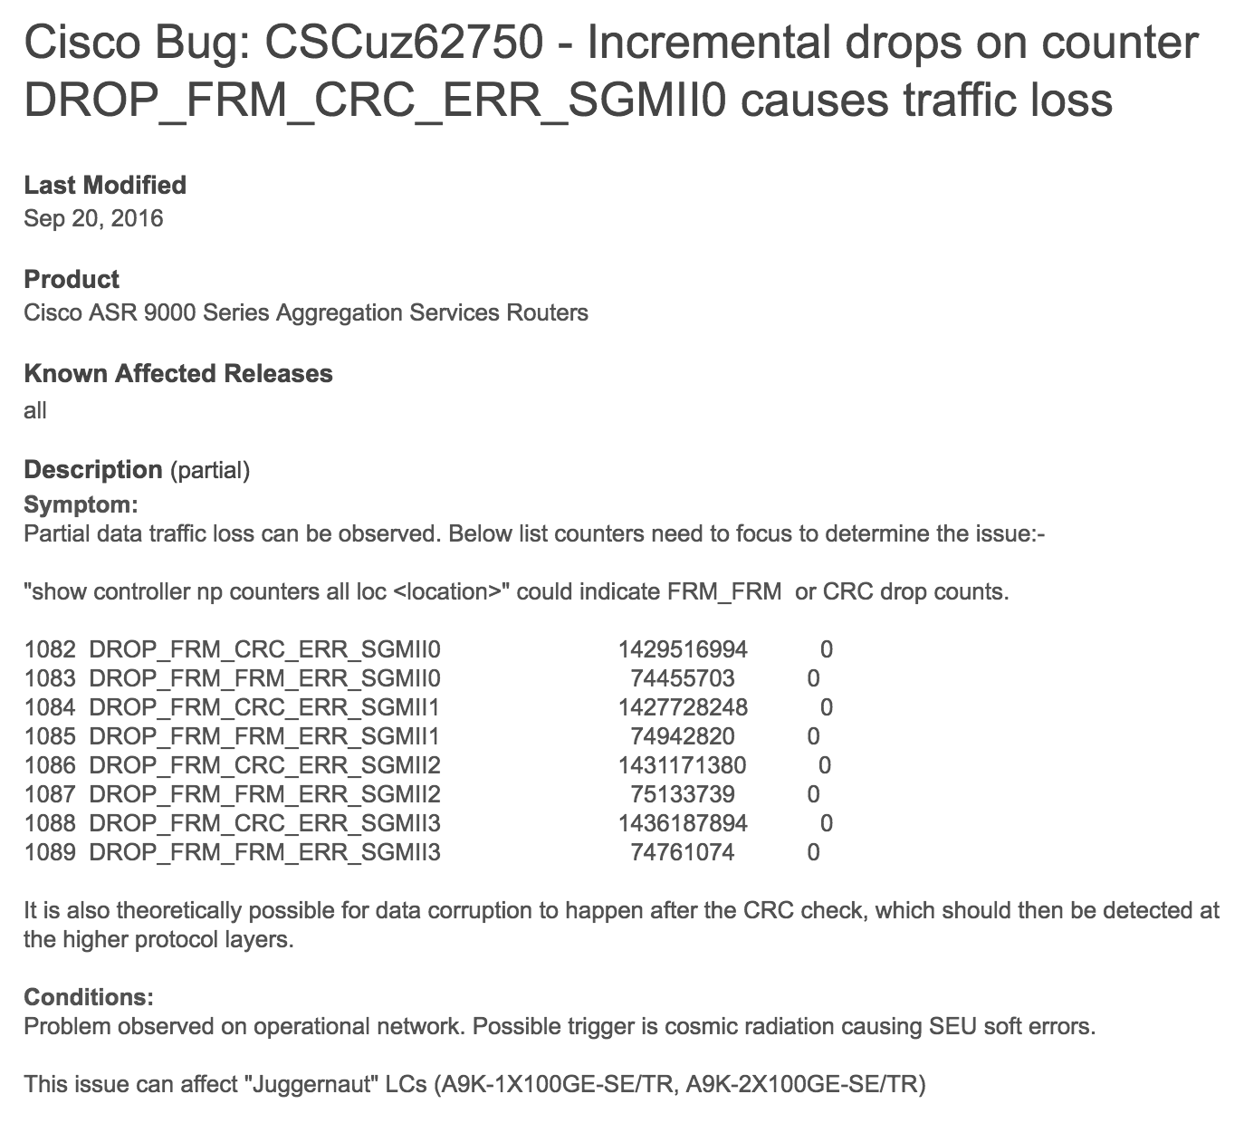
Bug Report
Cosmic radiatior

Slide 16
Tolerating Active Faults
Do nothing: let higher layer solve the failure
The more layers, the more difficult
Be fail-fast: report the problem
E.g., Ethernet stops sending and broadcasts when collision
Be fail-safe: transfer incorrect values to acceptable ones
E.g., blinking red light in all directions
Be fail-soft: continues to operate with degradation
E.g., airplane with three engines continues to fly if one has failure
Mask the error: makes incorrect value right

Slide 17
MTTF & Availability

Slide 18

MTTF, MTTR, MTBF
MTTF: mean time to failure
MTTR: mean time to repair
MTBF: mean time between failure
MTBF = MTTF + MTTR
TBF-1
TBF-2
TBF-3
TTR-1
TTF-1
TTR-2
TTF-2
TTR-3
TTF-3

Slide 19
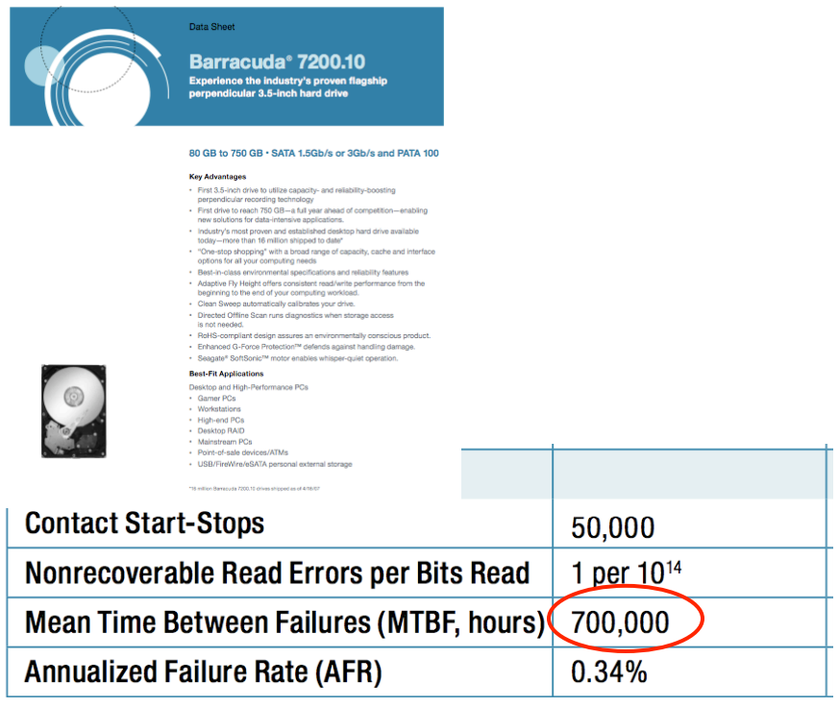
MTBF
Web page snapshot

Slide 20
Measuring MTBF
Two purposes: evaluating & predicting
The more reliable, the longer it takes to evaluate
Not measure directly, but use proxies to estimate its value
One way to measure "MTBF"
E.g. 3.5-inch disk's MTTF is 700,000 hours (80 years!)
Guess: ran 7,000 disks for 1,000 hours and 10 failed
If the failure process were memoryless, then OK
"expected operational lifetime" is only 5 years

Slide 21
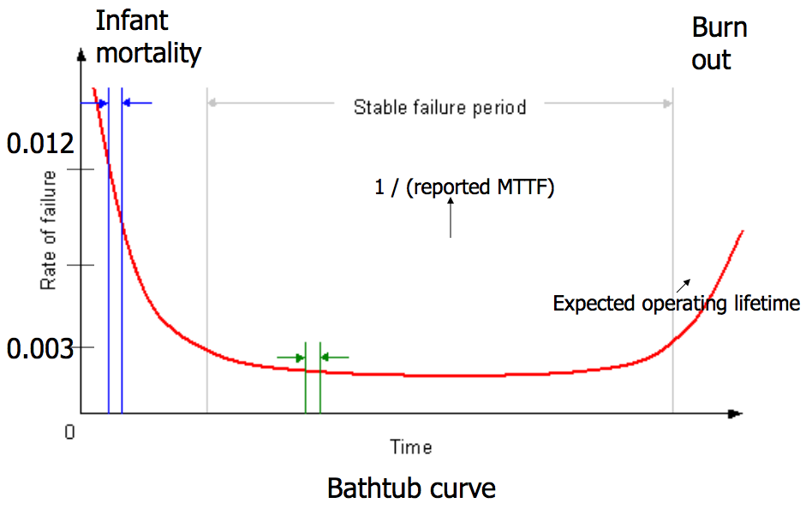
Bathtub Curve
gross manufacturing defects
run for a while before shipping
accumulated ware and tear cause failure

Slide 22
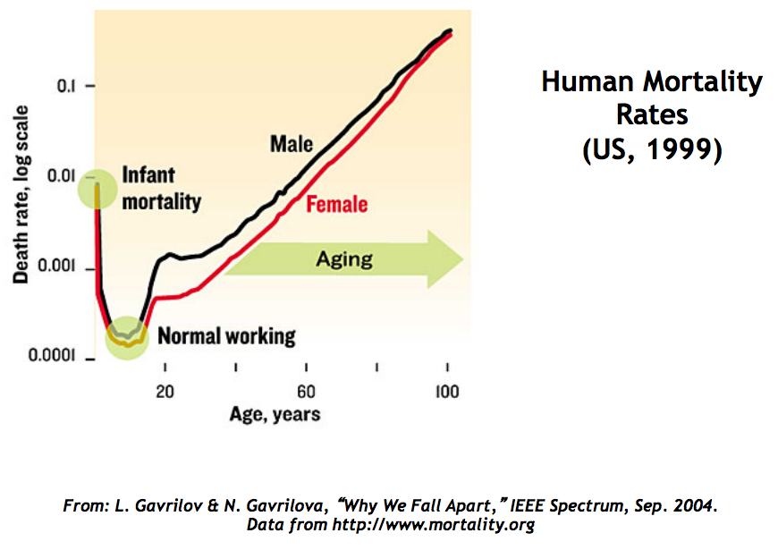

Slide 23
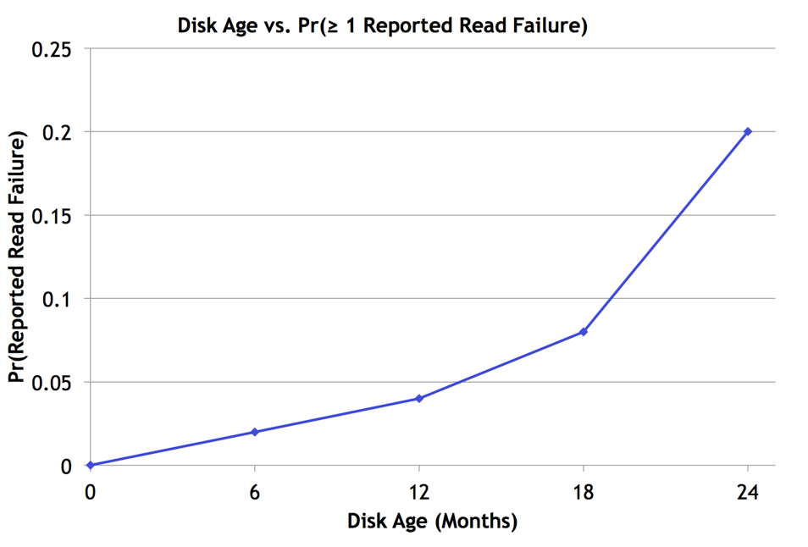
Bairavasundaram et al., SIGMETRICS 2007

Slide 24
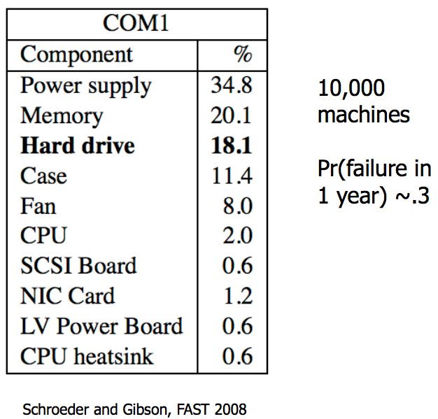
Frequency of Hardware Replacement

Slide 25
Availability
Counting the number of nines
E.g. 99.9% has 3-nines availability
Often used in marketing
Corresponding down time
E.g. 3-nines -> 8 hour/year
E.g. 5-nines -> 5 min/year
E.g. 7-nines -> 3 sec/year
Without any information about MTTF
More fine-grained
Fail-soft, as in 8.3

Slide 26
Availability in Practice
Carrier airlines (2002 FAA fact book)
99.9993% availability, 41 accidents, 6.7M departures
911 Phone service (1993 NRIC report)
99.994%, 29 minutes per line per year
Standard phone service (various sources)
99.99+%, 53+ minutes per line per year
End-to-end Internet Availability
95% - 99.6%

Slide 27
Redundancy

Slide 28
Systematically Applying Redundancy
Masking error
Analog system designer: margin
Digital system designer: redundancy
Outline
Coding: incremental redundancy
Replication: massive redundancy
Voting
Repair

Slide 29


Recall: Coding for Incremental Redundancy
Forward error correction
Perform coding before storing or transmitting
Later decode the data without appealing to the creator
Hamming distance
Number of 1 in A ⊕ B , ⊕ is exclusive OR (XOR)
If H-distance between every legitimate pair is 2
000101, can only detect 1-bit flip
If H-distance between every legitimate pair is 3
Can only correct 1 bit flip
If H-distance between every legitimate pair is 4
Can detect 2-bit flip, correct 1-bit flip

Slide 30
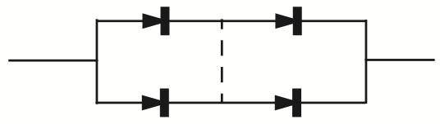
Replication: Massive Redundancy
Redundancy in bridge building
Material strength: 5 or 10 times as strong as min
Heavy-handed, but simple and effective
Replication
Replicas: identical multiple copies
E.g. Quad component by Shannon & Moore
Can tolerate single short circuit and single open circuit, and others
Mask failures silently

Slide 31

Voting
NMR: N-modular redundancy (supermodule)
E.g. TMR (3MR) and 5MR
Voter: compare the outputs with the same inputs
Can be applied at any level of module
Fail-vote: NMR with a majority voter
Raise an alert if any replicas disagree with majority
Signal a failure if no majority
Fail-fast only if any two replicas fail in different ways
If two replicas fail in same way, then not fail-fast

Slide 32

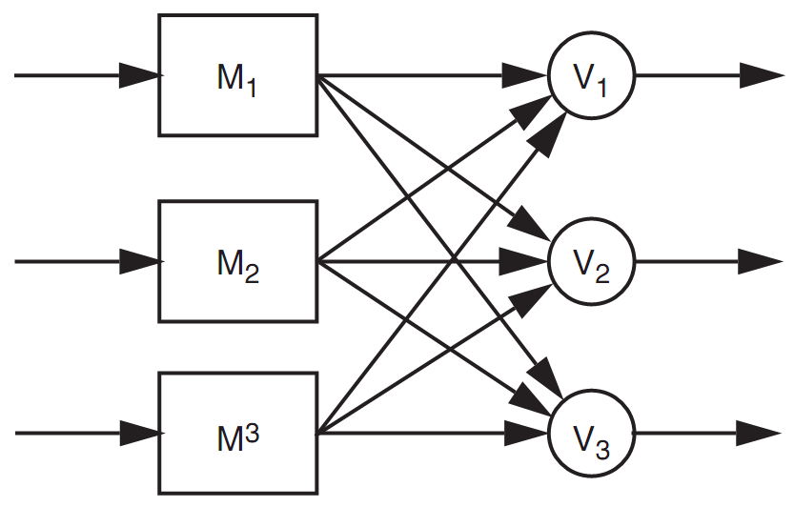
Voting
The probability that an incorrect result will be accepted by the voter is that it is no more than:
Assume the voter is perfectly reliable, which is not practical
Voter should also be replicated
Everything should be replicated
Recursive: voters belong to next module
Final voter should be the client

Slide 33
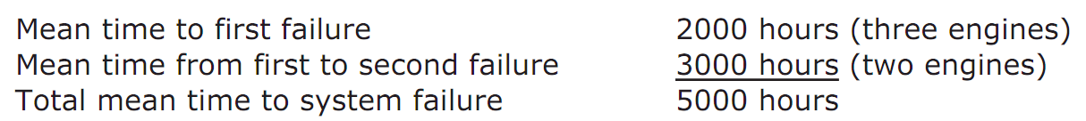
Voting
TMR can improve reliability
If R(T) = 0.999, TMR's R(T) = 0.999997
But MTTF can be smaller
If MTTF is 6,000 hours and fails independently, and the mechanism of engine failure is memoryless
6,000 hours in only 2,000 hours of flying, first fail
3,000 hours next and cause the second fail
5,000 hours < 6,000 hours

Slide 34
MTTF-replica and MTTF-system
If MTTF-replica = 1, N replicas total
Expected time until 1st failure is MTTF-replica/N
Expected time from then until the 2nd is MTTF-replica/(N-1)
Expected time until the system of N replicas fails is
For large N is approximately ln(N)
If mission time is long compared with MTTF-replica
Simple replication escalates the cost while providing little benefit

Slide 35
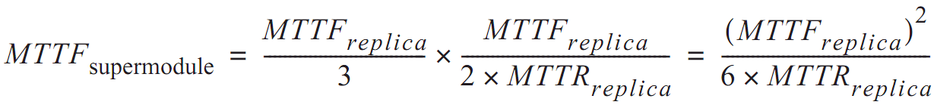
Repair
Return to fail-vote TMR supermodel
Requires at least two replicas be working
The rate of failure of 2 replicas is 2/MTTF
If replacement takes 1 hour, chance is 1/3000
Once replaced, expect to fly another 2000 hours until next engine failure
If we have unlimited replacement for 10,000 hours
MTTF = 6 million hours

Slide 36
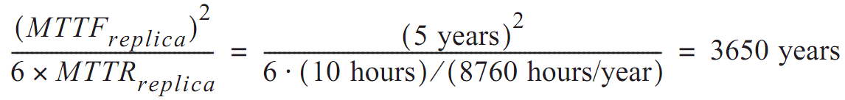
In another word
Although MTTF is reduced by the factor of 3
The availability of repair has increased MTTF by a factor equal to the ratio of the MTTF to MTTR of the remaining 2 engines
Disk with 3 replicas
If MTTF is 5-year, repair in 10 hours

Slide 37
Review Overly Optimistic Assumptions
Disks fail independently (?)
Same vendor, same fault
Earthquake, whose MTTF is less than 3650 years
Disk failures are memoryless (?)
Bathtub curve
Repair is also a memoryless process (?)
Stock enough spares
Repair is done flawlessly (?)
Replace the wrong disk, forget to copy data, etc.

Slide 38
Magnetic Disk Fault Tolerance

Slide 39
Magnetic Disk Fault Tolerance
Using disk as durable storage
Low cost, large capacity, non-volatility
Internal power can prevent data loss at power-off
Three/four nested layers
Raw storage, fail-fast storage, careful storage
Optional: durable storage

Slide 40
Magnetic Disk Fault Modes
Mechanical wear and tear
A bumping may cause a head to hit the surface
Head crush may also create cloud of dust
Results in several sectors decaying: decay set
Electronic components in the controller age
E.g. clock timing and signal detection circuits
Cause previously good data to become unreadable, or bad data to be written
Soft or hard errors
Seek error
Arm moves to a wrong track

Slide 41
ALL_OR_NOTHING_PUT
procedure ALMOST_ALL_OR_NOTHING_PUT (data, all_or_nothing_sector)
CAREFUL_PUT(data, all_or_nothing_sector.S1)
CAREFUL_PUT (data, all_or_nothing_sector.S2)
CAREFUL_PUT (data, all_or_nothing_sector.S3)
procedure ALL_OR_NOTHING_GET (reference date,all_or_nothing_sector)
CAREFUL_GET (data1, all_or_nothing_sector.S1)
CAREFUL_GET (data2, all_or_nothing_sector.S2)
CAREFUL_GET (data3, all_or_nothing_sector.S3)
if (data1 = data2) data ← data1
else data ← data3
Notes:
Why "Almost"?
- Not repair previous damage

Slide 42
ALL_OR_NOTHING_PUT
procedure ALL_OR_NOTHING_PUT (data, all_or_nothing_sector)
CHECK_AND_REPAIR (all_or_nothing_sector)
ALMOST_ALL_OR_NOTHING_PUT (data, all_or_nothing_sector)
procedure CHECK_AND_REPAIR (all_or_nothing_sector) // Ensure copies match
CAREFUL_GET (data1, all_or_nothing_sector.S1)
CAREFUL_GET (data2, all_or_nothing_sector.S2)
CAREFUL_GET (data3, all_or_nothing_sector.S3)

Slide 43
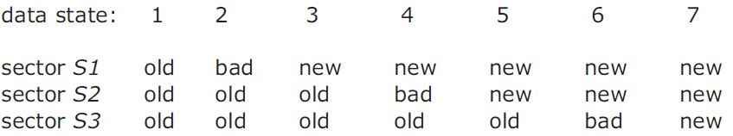
ALL_OR_NOTHING_PUT
if (data1 = data2) and (data2 = data3) return // State 1 or 7, no repair
if (data1 = data2)
CAREFUL_PUT (data1, all_or_nothing_sector.S3) return // State 5 or 6.
if (data2 = data3)
CAREFUL_PUT (data2, all_or_nothing_sector.S1) return // State 2 or 3.
CAREFUL_PUT (data1, all_or_nothing_sector.S2) // State 4, go to state 5
CAREFUL_PUT (data1, all_or_nothing_sector.S3 // State 5, go to state 7
Notes:
The choice of which to use is arbitrary; as shown the procedure copies the new value in sector S1 to both sectors S2 and S3.

Slide 44
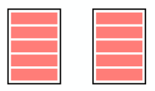
Durable Storage: RAID 1
Tolerate error
Hard errors reported by careful layer are masked by reading from other replicas
Untolerated error
Decay on the same sector of all the replicas, status = BAD
OS crashes during a DURABLE_PUT
Decay in a way that is undetectable
Redundant Array of
Independent Disks

Slide 45
Improving on RAID-1
Clerk: periodically checks for decays
T_{d} as the period, must short enough
Tolerated error
Hard errors reported by careful layer are masked by reading from one of the other replicas
Data of a single decay set decays, is discovered by the clerk, and is repaired, all within T_{d} of the decay event
Untolerated error
The OS crashes during DURABLE_PUT
All decay sets fail with T_{d}
The data of some sector decays in a way undetectable

Slide 46
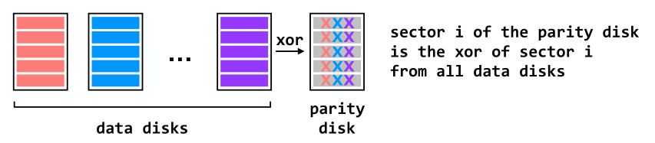
RAID 4 (Dedicated Parity Disk)
Can recover from single-disk failure
Requires N+1 disks (not 2N)
Performance benefits if stripe a single file across multiple data disks
- All writes hit the parity disk

Slide 47
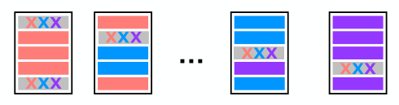
RAID 5 (Spread Out the Parity)
Can recover from single-disk failure
Requires N+1 disks (not 2N)
Better performance if stripe a single file across multiple data disks
Writes are spread across disks

Slide 48
Summary
Systems have faults. We have to take them into account and build reliable, fault-tolerant systems. Reliability always comes at a cost: there are tradeoffs between reliability and cost, reliability and simplicity, etc.
Our main tool for improving reliability is redundancy. One form of redundancy is replication, which can be used to combat many things including disk failures (important, disk failures mean lost data).
RAID replicates data across disks in a smart way: RAID 5 protects against single-disk failures while maintaining good performance.

Slide 49
More Case Studies

Slide 50
The U.S. National Archives
Preserve electronic records e.g., email
Daily incremental backups
periodic complete backups
audit logs for tracking actions
June 18-21, 1999, 43,000 emails disappeared
The audit log had been turned off for better performance
The contractor's employees never backup
Archives never verify the existence of backup copies
Lesson: Avoid rarely used components, must be tested periodically

Slide 51
Hospital Operating Room in Newark, New Jersey
Hospital operating room, with three backup generators
August 14, 2003, a widespread power grid failure
One backup generator caught fire from an oil leak
Another backup generator shut down due to overload
Hospital engineering turned off many circuit
Main power was interrupted to the OR
1. Rarely used component may not have been maintained properly
2. Human makes mistakes

Slide 52
World-Flight of Northwest Airline
2:05 p.m. on March 23, 2000
All communications dropped out
Six cables were accidentally bored through
Both primary and secondary!
Pilots resorted to manual procedures
Radio links were used
125 flights had to be cancelled
1. MTTF depend on that replicas are independent
2. FT measuring is difficult to test

Slide 53
British: Telehouse's Electricity
Safe against "fire, flooding, bombs, sabotage"
Especial protection against power failure
Including two independent connections to power grid
A room full of batteries, two diesel generators
Can detect failures automatically then switch
May 8, 1997…"It was due to human error.", which is not detectable
Identifying each potential fault and evaluate the risk is first step
People are part of the system, mistakes made by authorized operators are typically a bigger threat than trees falling on power lines

Slide 54
Kerosene Light in Radin, Poland
A town of Radin has a electricity generator
One day the machine broke
Darkness descended upon all of the streets
Even worse than the days without electricity
Every house had a kerosene light
Single point of failure: Centralization reduces robustness
Adding redundancy to a centralized design takes planning and adds to the cost

Slide 55
The SOHO Mission Interrupt
SOHO spacecraft was lost on June 25, 1998
"… a direct result of operational errors, a failure to adequately monitor spacecraft status, and an erroneous decision which …"
Five distinct direct causes of the loss
Three indirect causes in design process
Three indirect causes in operations procedures
1. Complex systems fail for complex reasons
2. When some components are people, multi-failures are too common

